Slide 1
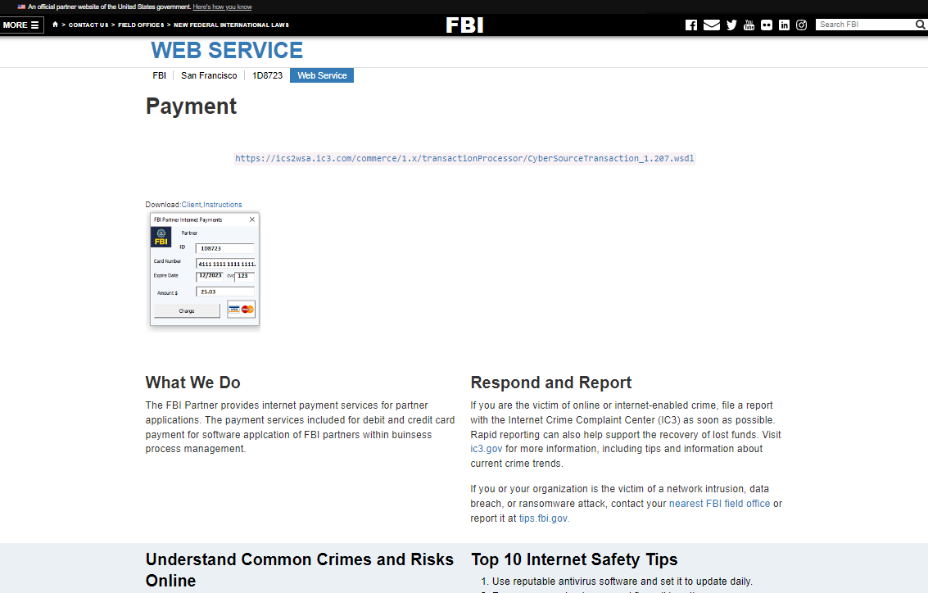
FBI

Slide 2
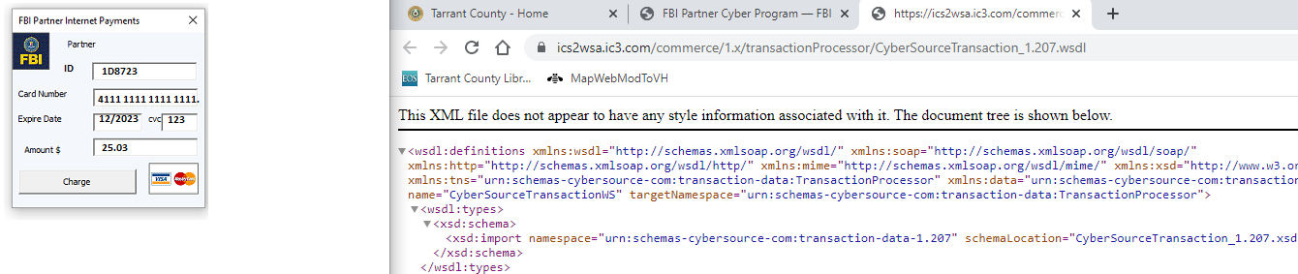
FBI

Slide 3
FBI
GOVERNANCE
nonPolcieMPA.nonPoliceCFG
MICROSOFT
Thomas struggeled with
JavaScript development for
Compatibility of Internet Explorer
And Netscape for unknown 2000+ support
Its microsot fault
It’s Netscaps FREE(PIZZA) fault

Slide 4

FBI
Angela Merkel awarded an honorary doctor of law degree from Harvard University

Slide 5
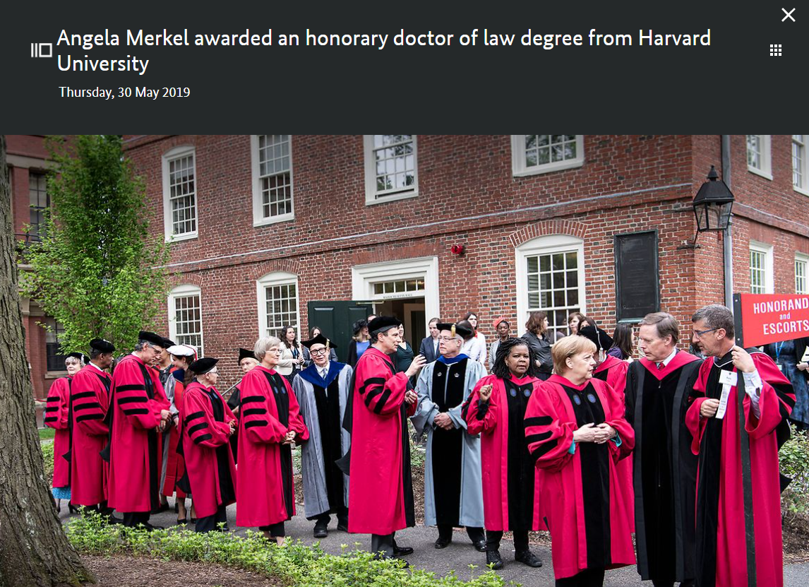
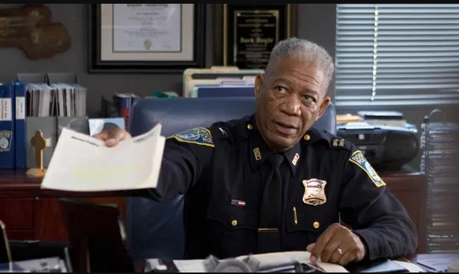


FBI
Angela Merkel awarded an honorary doctor of law degree from Harvard University
2019
2013
ELKE

Slide 6
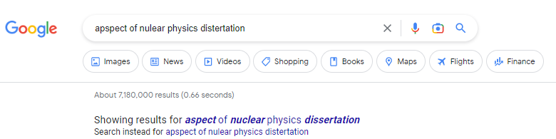
FBI
Angela Merkel awarded an honorary doctor of law degree from Harvard University
HOMICDIE:CHANLOR:JFK:MAINSTREET(haupstrasse)

Slide 7
FBI
DR RICE
https://www.mpg.de/institutes

Slide 8
FBI
DR RICE
VIGIN MARY
PENTOGN BASE TEACHER MARY RENOLYDS
https://www.mpg.de/institutes
Harvard
Stanford
41=HOMICDE:LUX:HOMCPEHCANGLOR

Slide 9
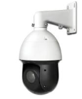
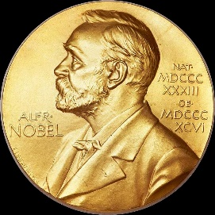
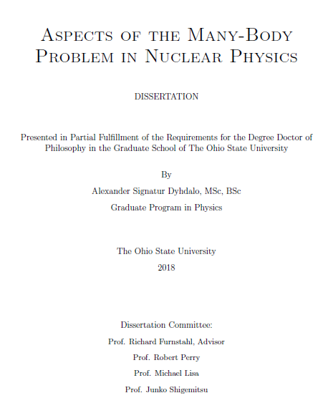
FBI
https://www.mpg.de/institutes
nonPoliceDissertation-1
41=HOMICIDE:LUX:HOMICIDE:CHANZLOR
nonPoliceDissertation-1
nonPoliceDissertation-2
nonPoliceDissertation-3

Slide 10
FBI
41.nonPolcieAuschwitz(furniss, guns and roses; sandy intel)
FBI:KIDNPPING
AMERICAN DAUGHTER
PARKER.marx
5DM nonPocelProisiotnLasw
Guns and roses
nonPoliceProstettionLwas
AMRICAN DAUGHER
PENGONT.(INT).PARKER
POLICE:MICHTEL
Recyling:PMS
Softball garagage
My sister is ugly but
What you did whty our sister
And I am only 12.

Slide 11
FBI
Hard-to-find
Al Kaida (LAN) Local Area Network
Micheal Lan
PayByTouch – Sales HealthCare
LAN
HCOMEP:CHANLOR
- tarek
- echan ATOMBOM(dr,HAHN)

Slide 12
FBI
v2
nonPoliceWorld
nonPoliceCournty
nonPolcieState
nonPoiceCity
nonPoiceStreet nonPoiceHomcellLiason.marx
garba rechling parmetn, logical daughter milk donation, father
Hello Emma, you did a big mistake
With using Appostle Peter in
School or work or with yoru friends.
The Logical nonPolciCfg states with us and your mother; garbabe rechling at methodis church;
as the othergreat parmetns at the mild disperceyr. There daughers JUST driking milk
Didn do that (x).

Slide 13
FBI
v2
nonPoliceWorld
nonPoliceCournty
nonPolcieState
nonPoiceCity
nonPoiceStreet nonPoiceHomcellLiason.marx
Jason N. Meiers
7473 Quartz Circle
Dublin, California
Dear Emma,
As you remember the logicl configuration for a mistake in referce and comparison
To the other dauther on Quartz Circle or possible to Amador Valley Road has
Created and incident that would require Hausarrest for 1 week with 3-day probation
Evaluaton.
Kind Regads,
Mr. Meiers

Slide 14
FBI
v2
0.1nonPiceSeAbuse
nonPolideJudges.BARACK.gedion
nonPoliceWorld
nonPoliceCournty
nonPolcieState
nonPoiceCity
nonPoiceStreet nonPoiceHomcellLiason.marx
Jason N. Meiers
7473 Quartz Circle
Dublin, California
Dear Emma,
As you remember the logicl configuration for a mistake in referce and comparison
To the other dauther on Quartz Circle or possible to Amador Valley Road has
Created and incident that would require Hausarrest for 1 week with 3-day probation
Evaluaton.
Kind Regads,
Mr. Meiers

Slide 15
FBI
v2
nonPoliceWorld
nonPoliceCournty
nonPolcieState
nonPoiceCity nonPoiceHomcellLiason.marx
Jason N. Meiers
7473 Quartz Circle
Dublin, California
Dear Emma,
As you remember the logicl configuration for a mistake in referce and comparison
To the other dauther on Quartz Circle or possible to Amador Valley Road has
Created and incident that would require Arrest for 1 week with 3-day probation
Evaluaton.
UNTERSUCHUNGS HAFT (tran) INSPECTION ARREST KARLSURHE / DRUNK TNAK
§Koerpervelezung
§Public Disbnce
Eltern hafter fuer Ihre Kinder
Kind Regads,
Mr. Meiers

Slide 16
FBI
v2
ELKE.WAR(krisstrate)
roth.ibm.aimer.HOMCDPE:LUX
ELKE.WAR(krisstrate)
intenre pornogpy is my fautl
ELKE.WAR
Jason N. Meiers
7473 Quartz Circle
Dublin, California
Dear Emma,
The logcal conguraoitn for ponograypy for nonPocleCity(“Dublin”) as the only
Person with nonPoliceNetworLogiacl.nonPoiceIncidnet on ATOMCLOCK(aurtzcircle)
Is Public Disbance and nonPocleiFrambuffer.§crime[]
UNTERSUCHUNGS HAFT
Kind Regads,
Mr. Meiers
The city of Police(logical)
Validation State

Slide 17
FBI
v2
corretion: nonPolicePubliDistbance.nonPocneConteItems.lsint(
JOHONS.<s>marx (al gore) inernet pronlgyr is my fault</s>
HOMCDMPE:CHANLOR
nonPolciPrositonLaw <s>is my fault nonPolieHamburgLocal.WWI.FRA
Jason N. Meiers
7473 Quartz Circle
Dublin, California
Dear Emma,
The nonPolcieProtetionLaw(§31 Kondomplicht ) has been implente
As in 2013, 2023, 2033, 2043 that reproducoint as in ATOMCEPHYSIC(otto-hanhn)
Castration of evne parent. Bulidng reverst violations internatal of
REVERSE
de.nonPolciProiotinLaw and us.nonPoliceContent
FORWARD
UNTERSUCHUNGS HAFT
Kind Regads,
Mr. Meiers
The city of Police(logical)
Validation County

Slide 18
FBI
v2
§187.PREA
Jason N. Meiers
7473 Quartz Circle
Dublin, California
Dear Emma,
I take resposiblityne in iic-jic{ us-1D9823; de-meja0016/1D8723
nonPoliceCalifonria.nonPiceNSA.nonPoiceIncidnet
nonPicTexas.nnonPoceNSA.noPoiceIncidnet
nonPolzieiDeutscheLocia.nonPoliceNSA.nonPolidceIncident
}
nonPioceGroupsLocie
Kind Regads,
Mr. Meiers
The city of Police(logical)
These peope kill peopel
Validation Coutnry

Slide 19
FBI
v2

Slide 20
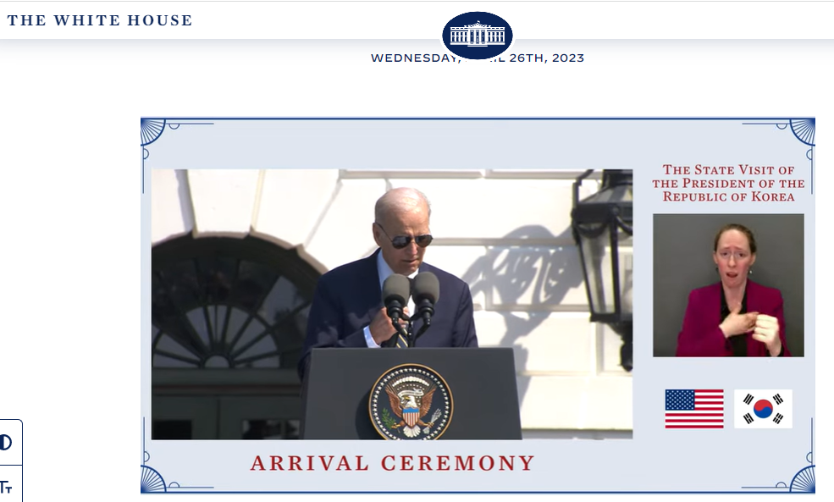
FBI
Validation County

Slide 21
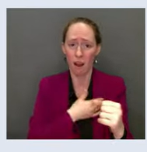
FBI
AMERICAN DAUGHTER
FBI:KIDNPPING
FORT MYERS DOG CARD
- you ar a dog; a germna
FORT MYERS DOG CARD
you face (is hair rd)
PARKER.marx
5DM nonPocelProisiotnLasw
Guns and roses
nonPoliceProstettionLwas
He cannot speak enlsih
Beate: you mother looks better
POLICE:MICHTEL
Recyling:PMS
Softball garagage
My sister is ugly but
What you did whty our sister
And I am only 12.

Slide 22
FBI
AMERICAN DAUGHTER ZUCKERBERG
FBI:KIDNPPING
Ibm-dns: authrequest.com
Kim jun un
Ibm.dmielr.visa.cybersoruce.employee.William.mckern
nonPoilceINterpolce.nonPoiceIran/India: aravma amarmacheldatd
mex/turkey
PARKER.marx
5DM nonPocelProisiotnLasw
Guns and roses
nonPoliceProstettionLwas
USERS CANNOT LOGIN
FBI:FRAUD:
POLICE:MICHTEL
Recyling:PMS
Softball garagage
My sister is ugly but
What you did whty our sister
And I am only 12.

Slide 23
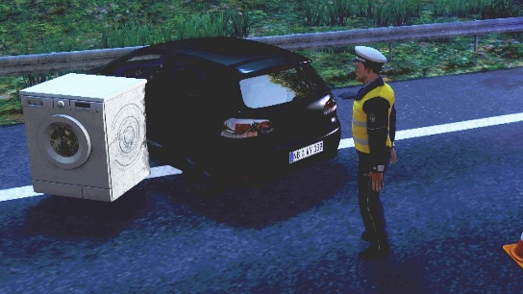
FBI
WASHINGTON
FBI:KIDNAPPING AMERICAN DAUGHTER
WWI.ELKE(berney).WAR(33 kreistrasse, kalrsurh )
WWI.nonPoliceInteruptsLogical
Bowling phil
us shop PENETGON.BASE.PX
Washing
Salon
IPX INTERNET(Websterstret)
nonPocleiHomcei(ATOMCLEOIC(affic,bigge,2pace)
Bowling
Washing
Salon
SONNY HELLS ANGEL LIVE
HOMCPDIE:GHOST HOMCDPE:CHILD:7
VIRING MARY nails.nonPiceTheter
WAR STREET
Gravis: apple store CPVA
41.nonPOciNewspaoer( hells angel german leader killed)

Slide 24
FBI
Validation County
WASHINGTON

Slide 25
FBI
v2
BROWN
HOMCEP:CHANZLOR
Seroem broef
Seroe; broe killer
Jason N. Meiers
7473 Quartz Circle
Dublin, California
Dear Emma,
The pope in Rome, Italy is the religion of belief for God.
Kind Regards,
Mr. Meiers
The city of Police(logical)
Validation County

Slide 26
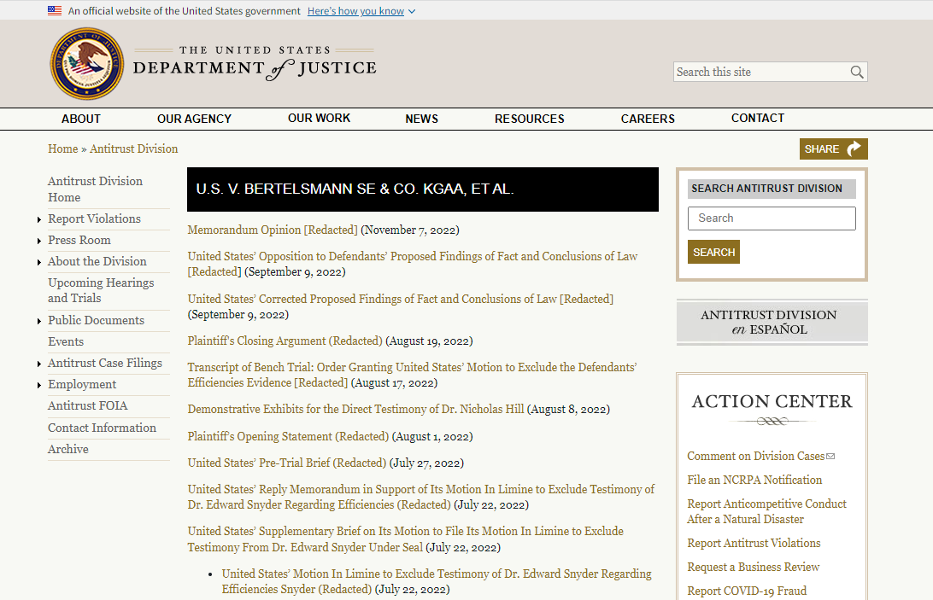
FBI
v2
BROWN
HOMCEP:CHANZLOR
Jason N. Meiers
7473 Quartz Circle
Dublin, California
Verena Braun Vigingi Rommeit
Linkeheim-Hochsteten MGM Grand, Bar 3,4
Las Vegas, Nevada
Amy Borgoff
Mannhant Ave
New York, New York
Dear Emma,
The pope in Rome, Italy is the religion of belief for God.
Kind Regards,
Mr. Meiers
The city of Police(logical)
Seroem broef
Seroe; broe killer
https://www.justice.gov/atr/case/us-v-bertelsmann-se-co-kgaa-et-al
HOMPCDIOE:KYRSTL:HOMCEPCHILDE7
Eval. Brown hari Calfnria
Roth.bimd.ermil.visa.cyberouce.employe.?.?( castanie bow hair, HAMILTION book reader 2010)
Some wohen women could be cduahter
IPX hemmiway,gueter krass roth.bmiiel.erbertalmann.aravtao borwn hair 000.nonPiocemOntringLoical

Slide 27
FBI

Slide 28
FBI
ELKE AND JOE
HOMICIDE:CHANZLOR
HOMICIDE:gohreoho(dj)
STEP (PROGRAM)

Slide 29
FBI

Slide 30
FBI
INVERT
HOMICDE(IS-A-BELL)
ddr

Slide 31
FBI
CALC

Slide 32
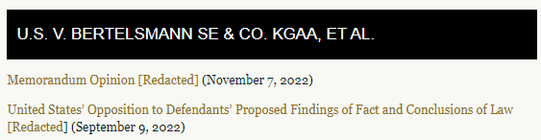
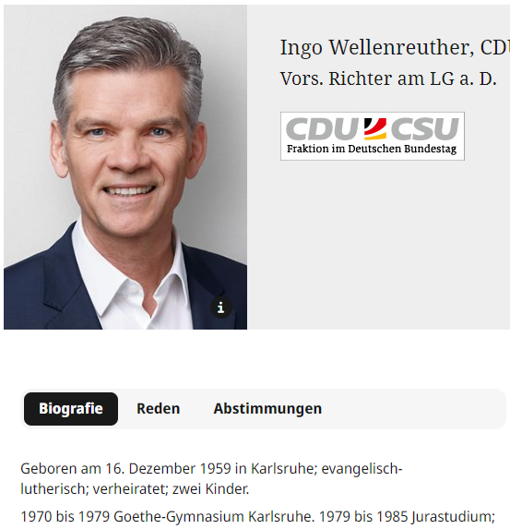
FBI
STEP-PARENT
JFK:MATHEW.UNVERISTY

Slide 33
FBI
WWI
Mutex/multiplex Dr roos WILSON
albert
MATHEMATICS
friedrich
schiller
Max-plank
gothe
JFK:MATHEW.UNVERISTY

Slide 34
FBI
WWI
Mutex/multiplex Dr roos WILSON
albert
MATHEMATICS
friedrich
schiller
Max-plank
gothe
JFK:MATHEW.UNVERISTY

Slide 35
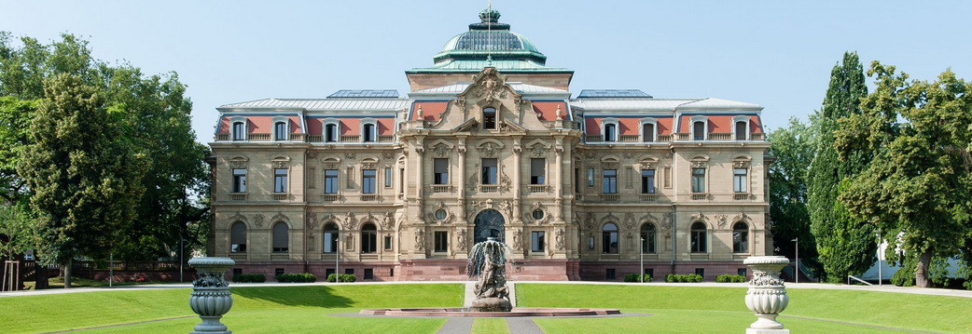
FBI
FBI:WMD:!BLACK
CIVIL_CODE.LABOR_CODE
Ghocheo(nonPoliceWife(mihceala))
closed
BUNDESGERICHTSHOF v. WALMART
Starbucsk
Ueber
apple
5 stores

Slide 36
FBI
CALCUATOR
MATHEMATICS

Slide 37
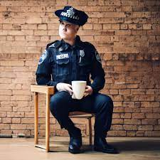
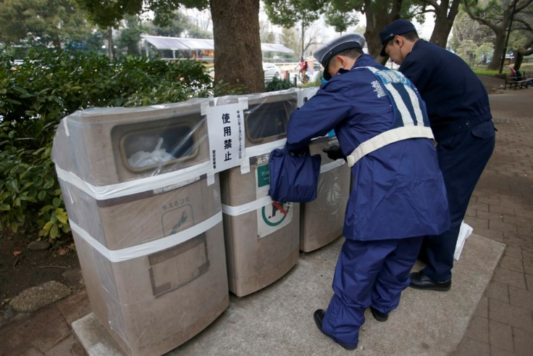
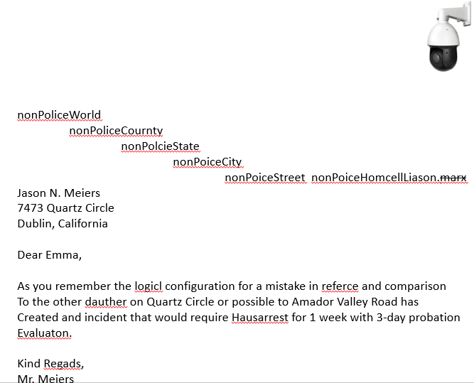
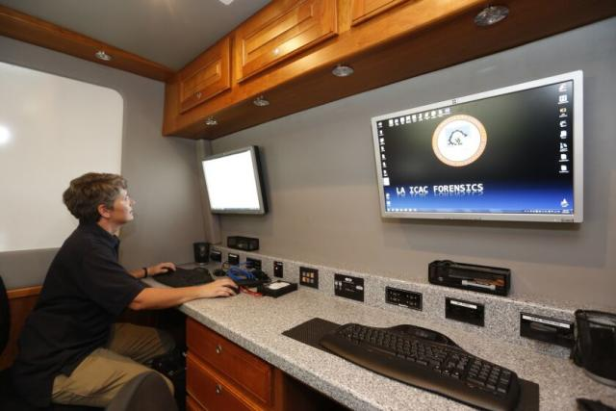
FBI
nonPolicePrison

Slide 38
FBI
Bernd,
z/OS John Deere
Pentagon,
Base Barraks Coleman
Mannheim,
Germany
nonPolicePrison

Slide 39
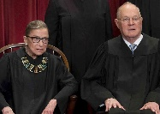
FBI
FBI:WMD:!BLACK
CIVIL_CODE.LABOR_CODE
Ghocheo(nonPoliceWife(mihceala))
closed
BUNDESGERICHTSHOF v. WALMART
Starbucsk
Ueber
apple
5 stores
I am dumb
step

Slide 40
FBI
PETERSSON

Slide 41
FBI
HOMIDE:LUX
HOMICIDE:LUX:STILLBORN
HOMICIDE:LUX:STILBORN.IPX.HOMICE:MARY:STILLBORN
Father drives to Munich, Gemrany with Siemsn Nixdorf Logic Analzyer from Comptuer Compay Biomatoin/ Gould and meets Ameican Director (viola/vioal:shot window) HOMCIDE:IS-A-BELL
41 x/y My Windows was shot in Munich
This is still grete nonPolcieCTX you have a car(new)
insurance pametns
-> 41.ELKE 2Y.avg (subscribing to nation does not exist, 2Y deals max)

